Slide 1
Risk Management in Agile and DevOps
Balancing Speed and Security

Slide 2
Importance of Risk Management
Neglecting Risk Management:
Budget Overruns: Without a plan for unexpected issues, we might spend more money than we have for the project.
Project Delays: If we don't deal with potential problems early on, our project might take longer than we planned.
Effective Risk Management:
Resource Optimization: Planning how we use our resources smartly helps us avoid roadblocks and keeps our project running smoothly.
Proactive Issue Resolution: Fixing problems early stops them from becoming big issues.

Slide 3
Common Risks in Agile and DevOps
Rapid changes in requirements
Communication gaps
Integration issues
Security vulnerabilities
Lack of Stakeholder Involvement
Lack of Automated Testing

Slide 4
Agile Practices to Mitigate Risks
Iterative Development
Emphasizes breaking down the project into smaller, manageable increments.
Mitigates Risk: Reduces the impact of potential errors by allowing for early detection and correction in each iteration.
Continuous Feedback
Encourages regular and constructive communication among team members, stakeholders, and end-users.
Mitigates Risk: Facilitates early identification of issues, evolving requirements, and aligns the project with stakeholders' expectations.
Daily Stand-up Meetings (Scrum)
Brief, daily meetings where team members discuss progress, challenges, and plans for the day.
Mitigates Risk: Promotes real-time problem-solving, enhances team collaboration, and keeps everyone informed, preventing potential bottlenecks.

Slide 5
DevOps Practices to Mitigate Risks
Continuous Integration:
Combines code changes regularly, allowing teams to detect and address integration issues early.
Ensures that the entire codebase is regularly validated.
Continuous Delivery:
Automates the deployment process, reducing the likelihood of deployment errors.
Facilitates faster and more reliable releases, enhancing overall system stability.
Infrastructure as Code (IaC):
Represents infrastructure configurations as code, allowing for version control and reproducibility.
Enables consistent and automated provisioning of infrastructure, minimizing configuration errors.

Slide 6
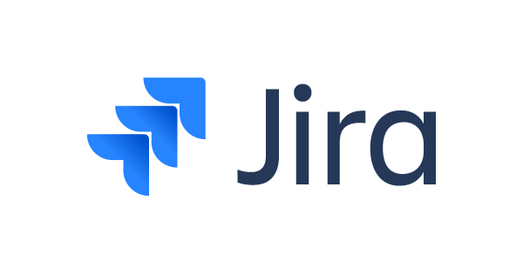

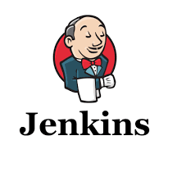

Tools for Risk Management
Agile:
Jira: Plan, track, and manage Agile work.
Trello: Simple visual collaboration for Agile teams.
DevOps:
Jenkins: Automate building and deployment.
GitLab: End-to-end DevOps platform.

Slide 7
Thanks!

